Slide 1
Fort Lauderdale, FL USA December 14, 2019

Slide 2






Sentiment Prediction Real-time in SQL Server
Fort Lauderdale, FL USA
Hiram Fleitas
@hiramfleitas
bit.ly/gaib2019
hiram@fleitasarts.com
fleitasarts.com
/hfleitas
hiramfleitas

Slide 3
Agenda
Setup
Debugging
Performance
Cognitive API
Spark Streaming

Slide 4
Demo One
Add ML Features
Grant Access & Configure
Install Pre-Trained Models

Slide 5
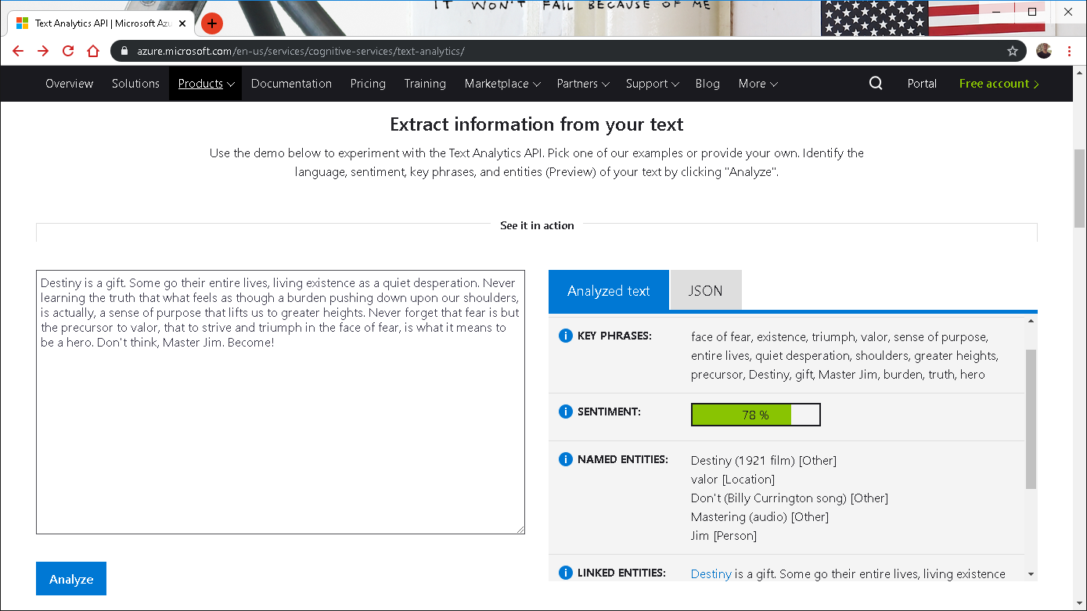

Notes:
https://www.netflix.com/title/80075820

Slide 6
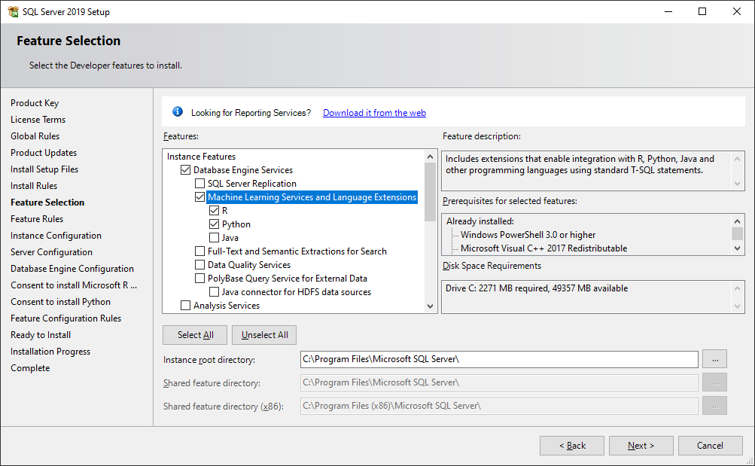
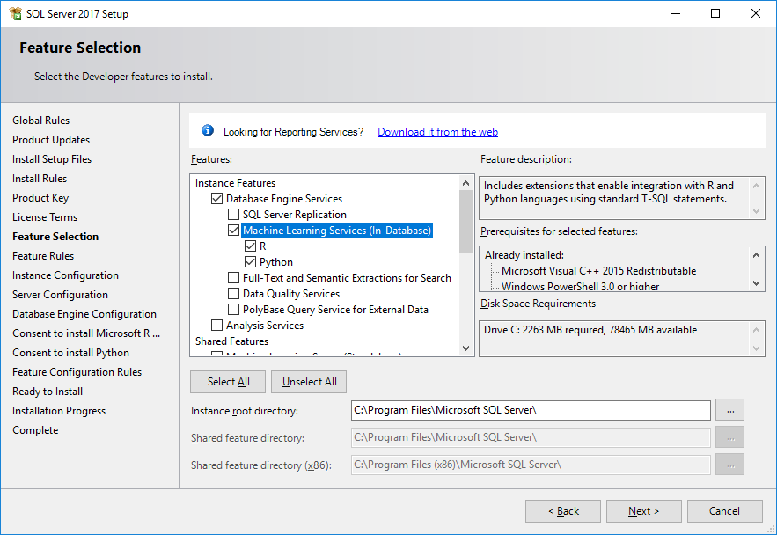

Slide 7
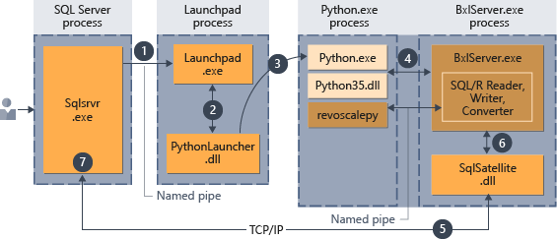
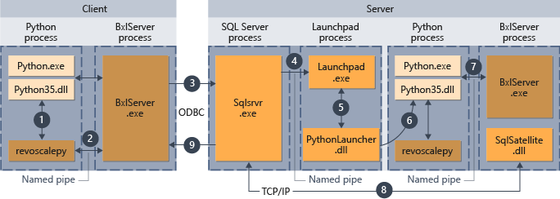
Execution Architecture
Learn more:
https://docs.microsoft.com/en-us/sql/advanced-analytics/concepts/extension-python
https://docs.microsoft.com/en-us/sql/advanced-analytics/install/sql-server-machine-learning-services-2019
https://docs.microsoft.com/en-us/sql/advanced-analytics/data-collection-ml-troubleshooting-process
Notes:
Execution Architecture: https://docs.microsoft.com/en-us/sql/advanced-analytics/concepts/extension-python
Isolation Changes: https://docs.microsoft.com/en-us/sql/advanced-analytics/install/sql-server-machine-learning-services-2019
Troubleshoot data collection for ML: https://docs.microsoft.com/en-us/sql/advanced-analytics/data-collection-ml-troubleshooting-process

Slide 8
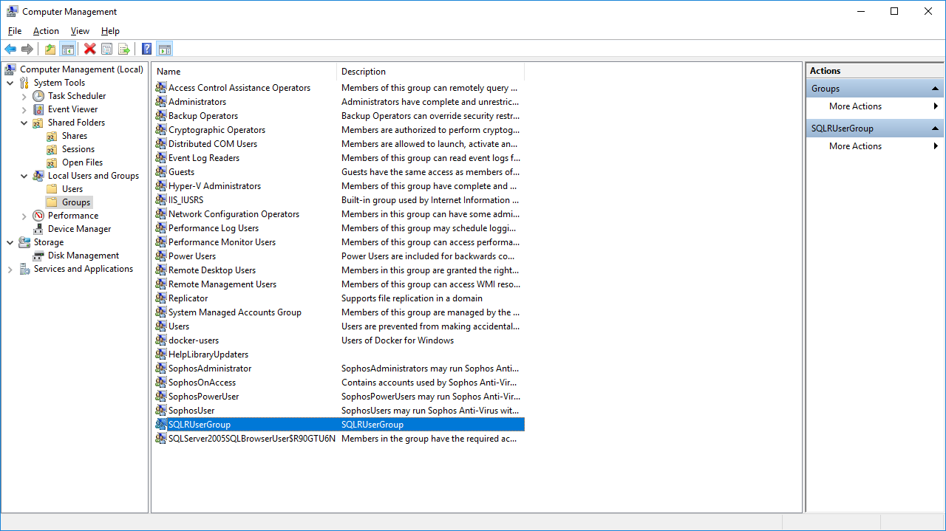
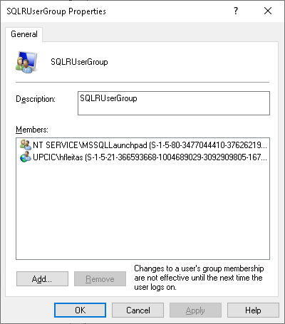
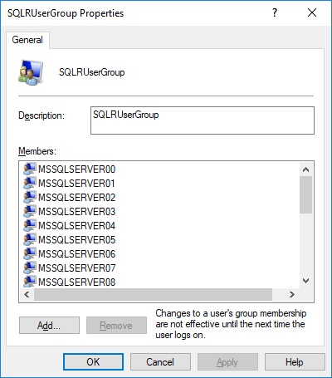

Slide 9
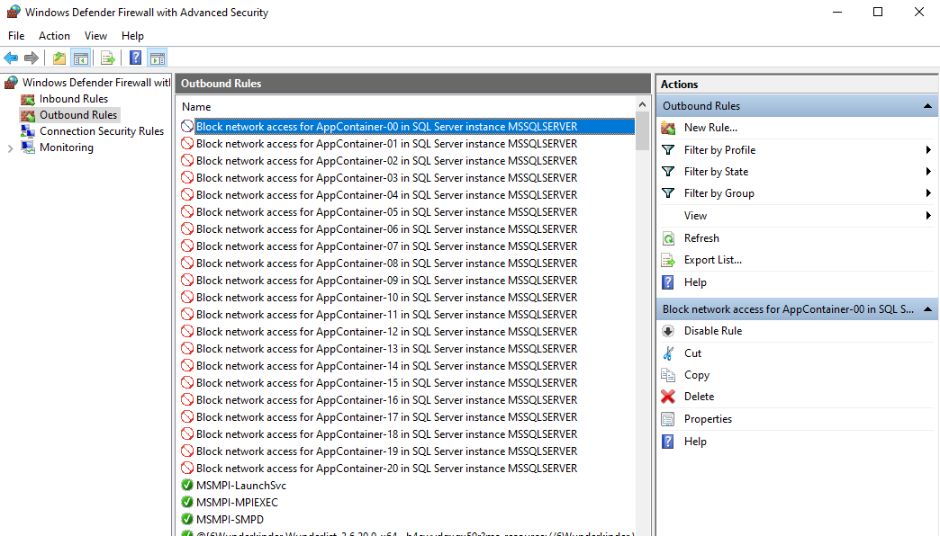

Slide 10
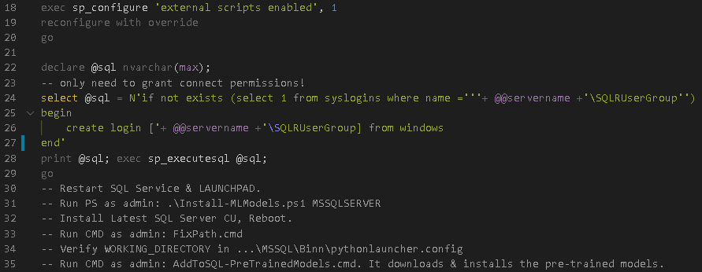

Slide 11
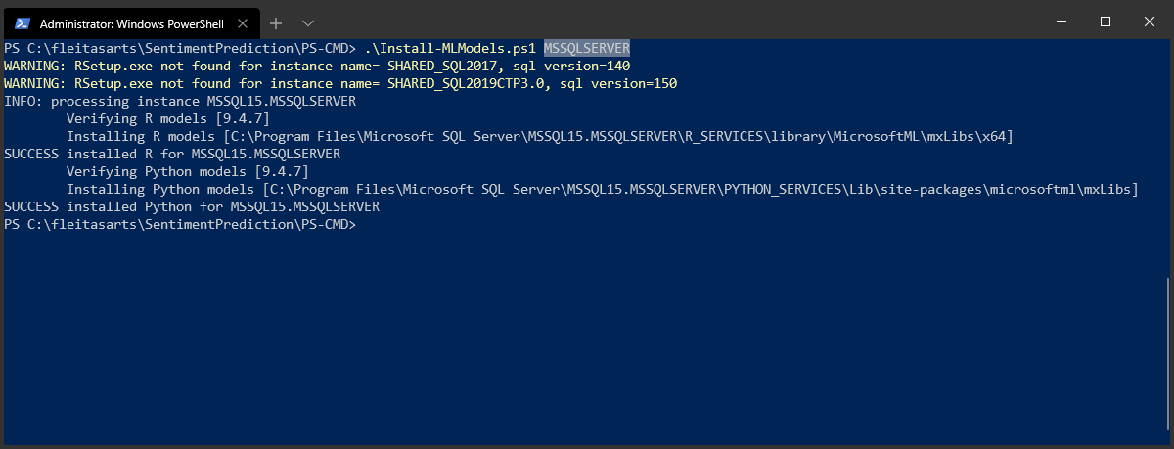
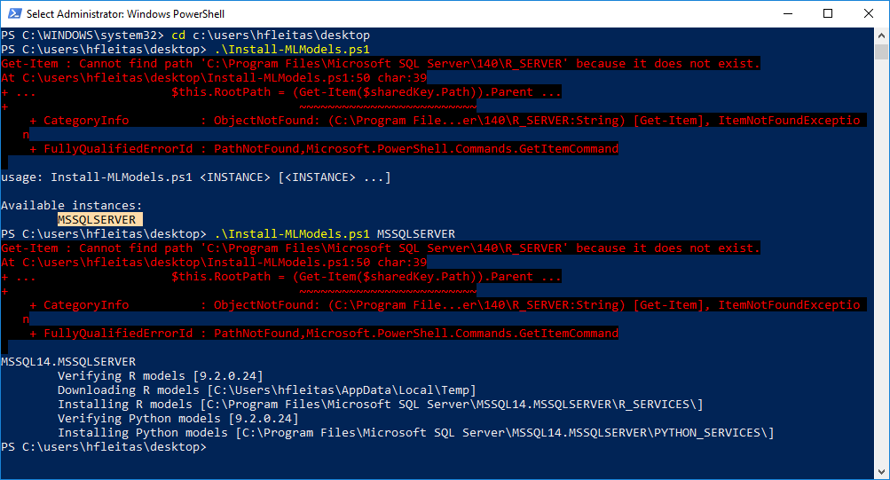
Notes:
https://docs.microsoft.com/en-us/sql/advanced-analytics/install/sql-pretrained-models-install?view=sql-server-ver15
https://github.com/MicrosoftDocs/sql-docs/issues/2207

Slide 12
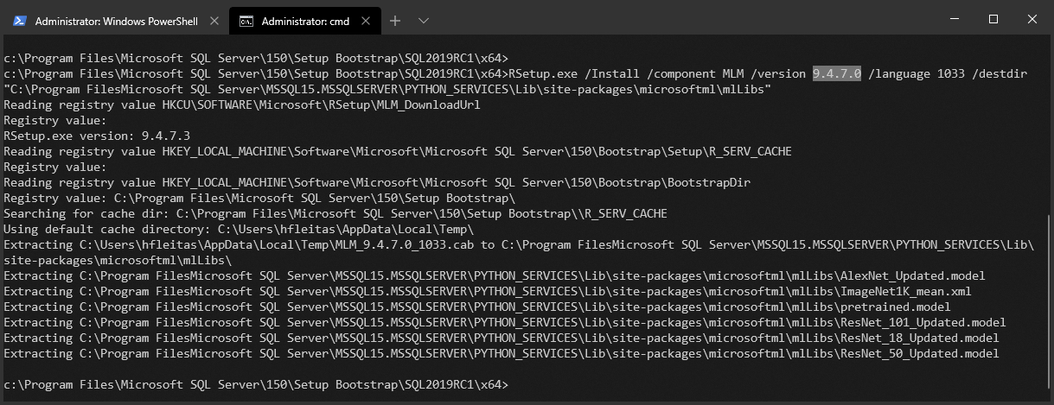
Notes:
rem 2019
cd c:\Program Files\Microsoft SQL Server\150\Setup Bootstrap\SQL2019RC1\x64
RSetup.exe /install /component MLM /version 9.4.7.0 /language 1033 /destdir "C:\Program Files\Microsoft SQL Server\MSSQL15.MSSQLSERVER\PYTHON_SERVICES\Lib\site-packages\microsoftml\mxLibs"

Slide 13
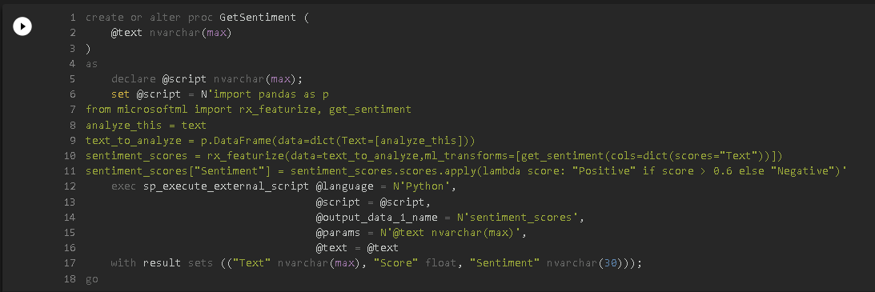

Slide 14
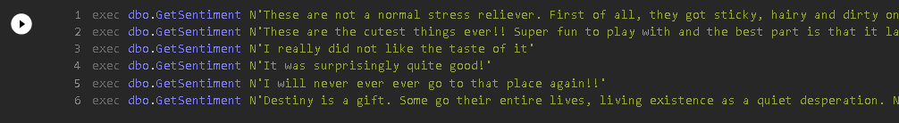
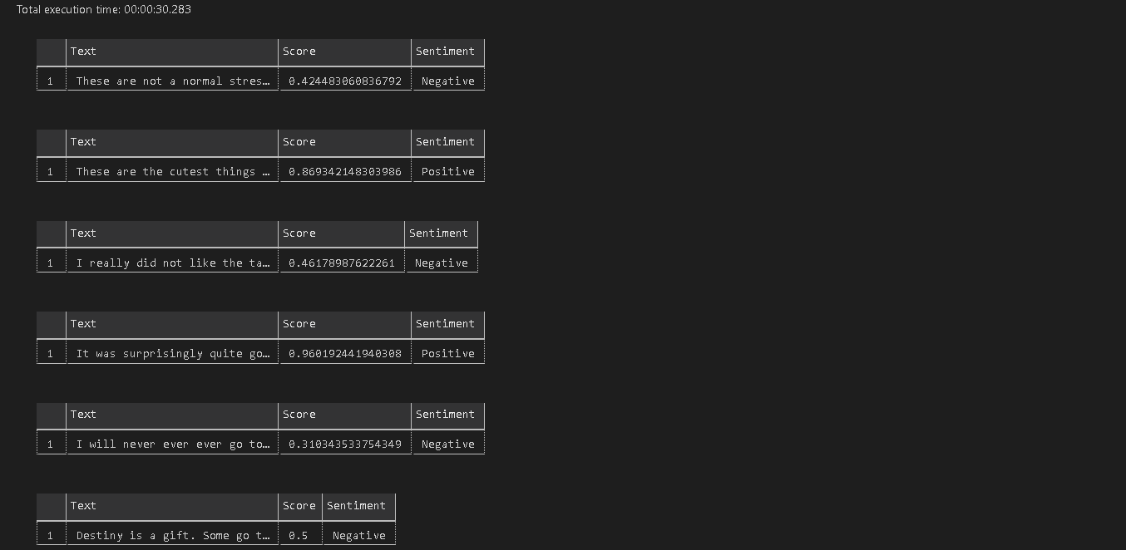

Slide 15
Demo Two
Requirements.txt
Common Vulnerabilities
Python Profiling

Slide 16
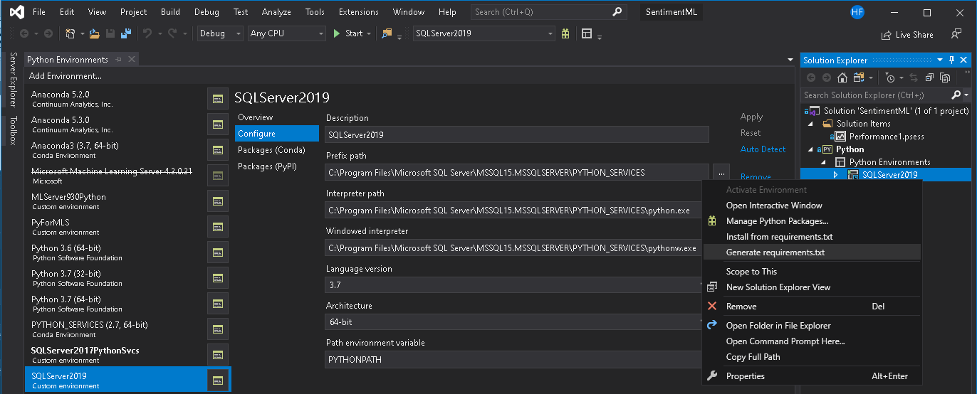

Notes:
CVE® is a list of entries—each containing an identification number, a description, and at least one public reference—for publicly known cybersecurity vulnerabilities.
https://cve.mitre.org/

Slide 17
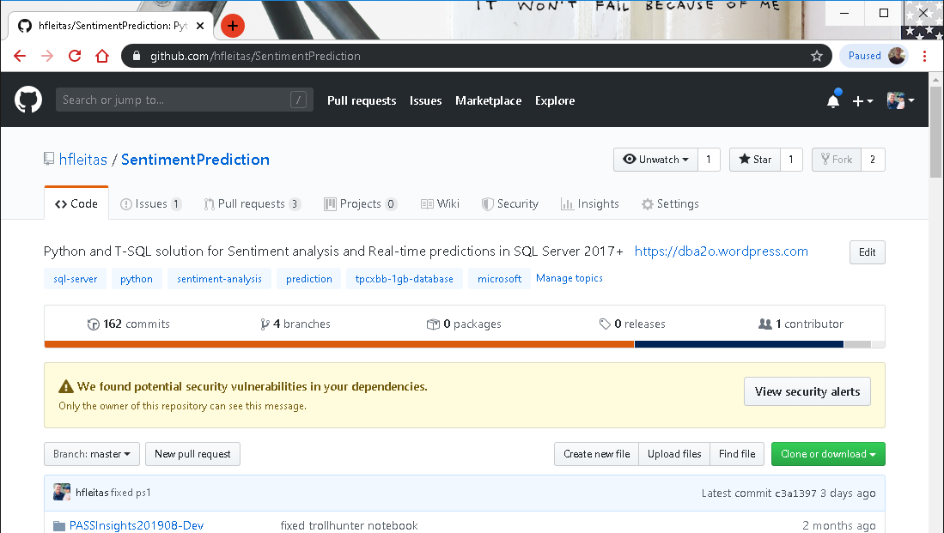
Notes:
CVE® is a list of entries—each containing an identification number, a description, and at least one public reference—for publicly known cybersecurity vulnerabilities.
https://cve.mitre.org/

Slide 18
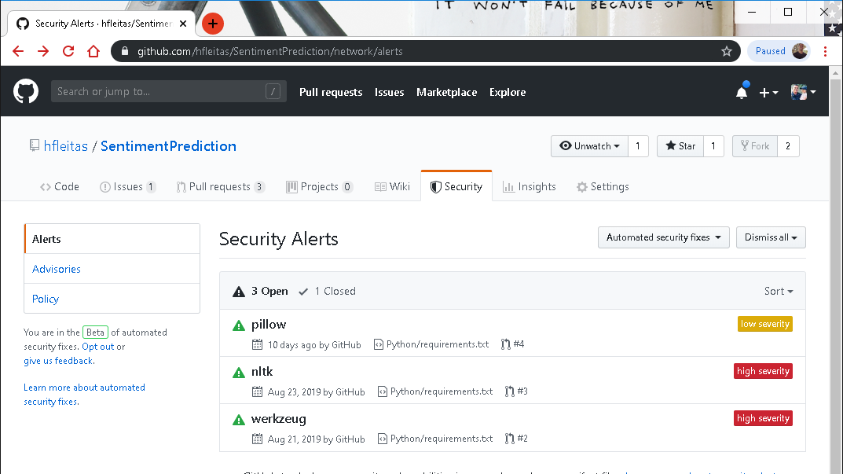
Notes:
CVE® is a list of entries—each containing an identification number, a description, and at least one public reference—for publicly known cybersecurity vulnerabilities.
https://cve.mitre.org/

Slide 19
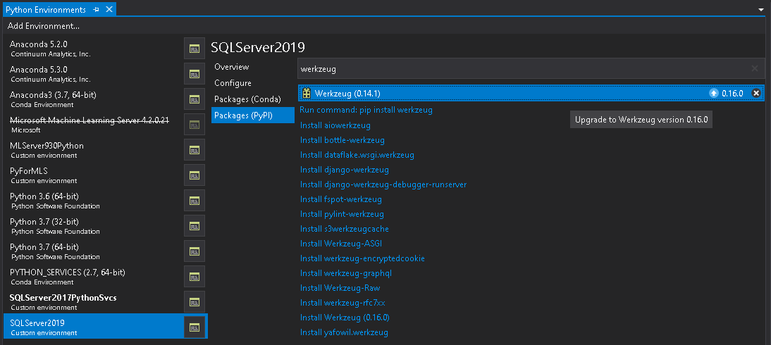

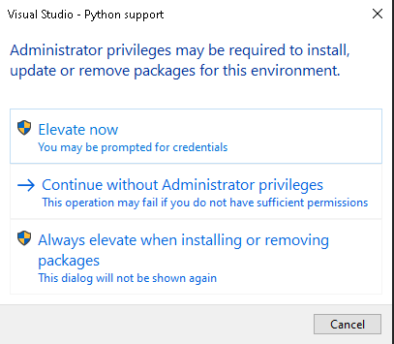
Admin cmd or PowerShell:
python.exe -m pip install -U pkgname==x.y.z
python.exe -m pip list
Notes:
CVE® is a list of entries—each containing an identification number, a description, and at least one public reference—for publicly known cybersecurity vulnerabilities.
https://cve.mitre.org/

Slide 20
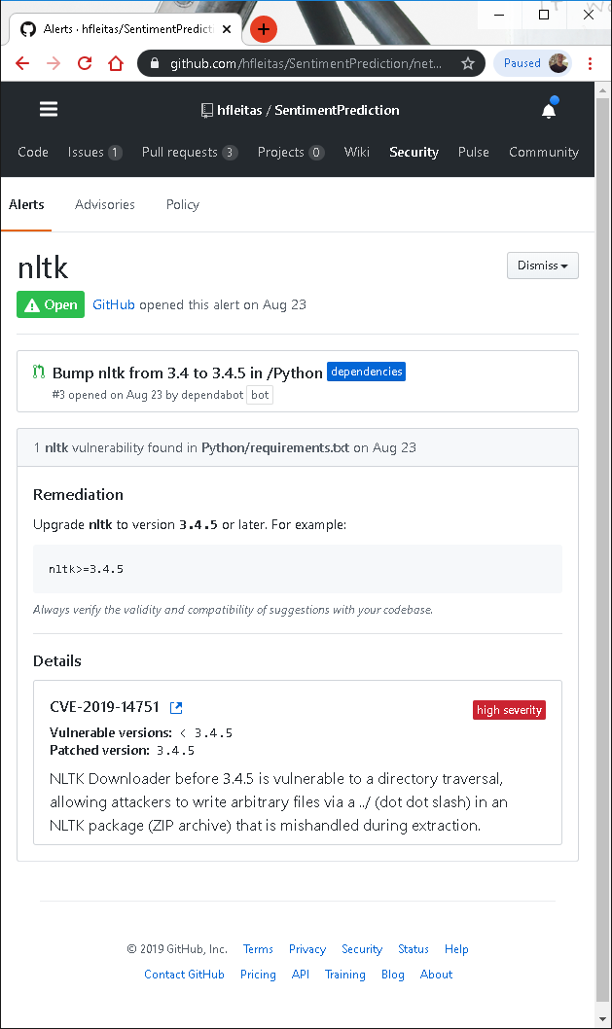
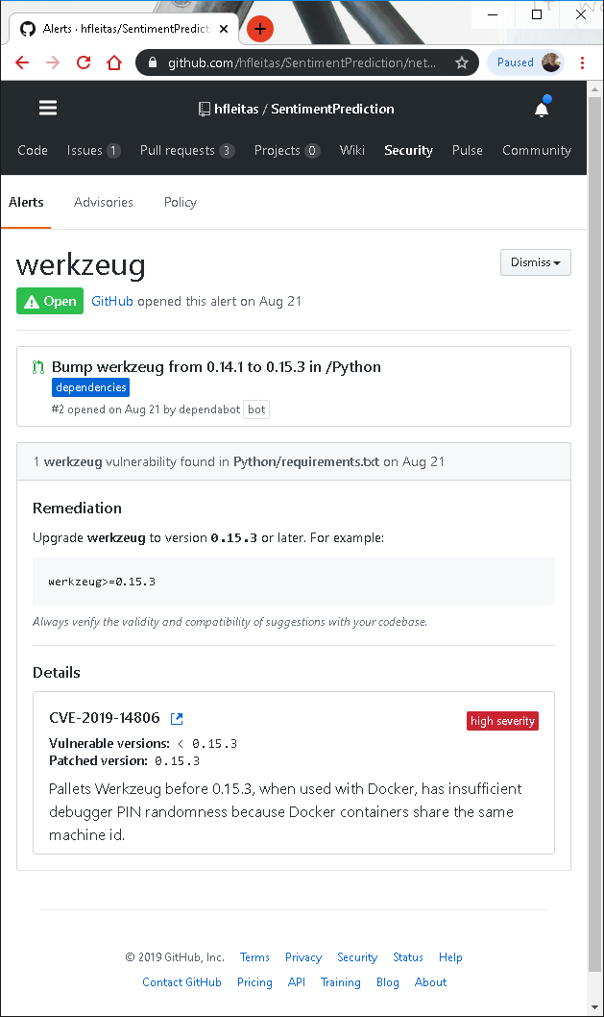
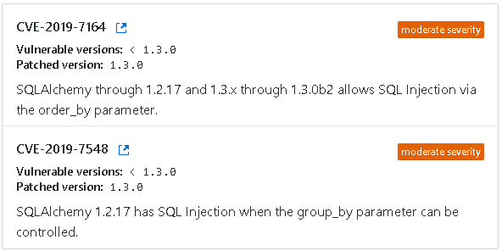
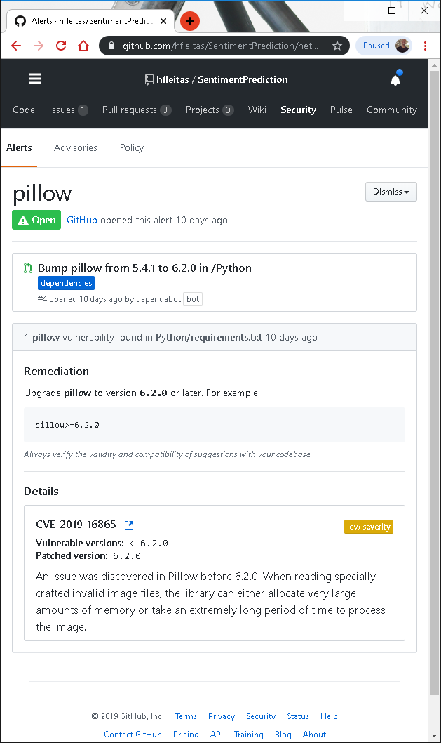
Details
Notes:
CVE® is a list of entries—each containing an identification number, a description, and at least one public reference—for publicly known cybersecurity vulnerabilities.
https://cve.mitre.org/

Slide 21
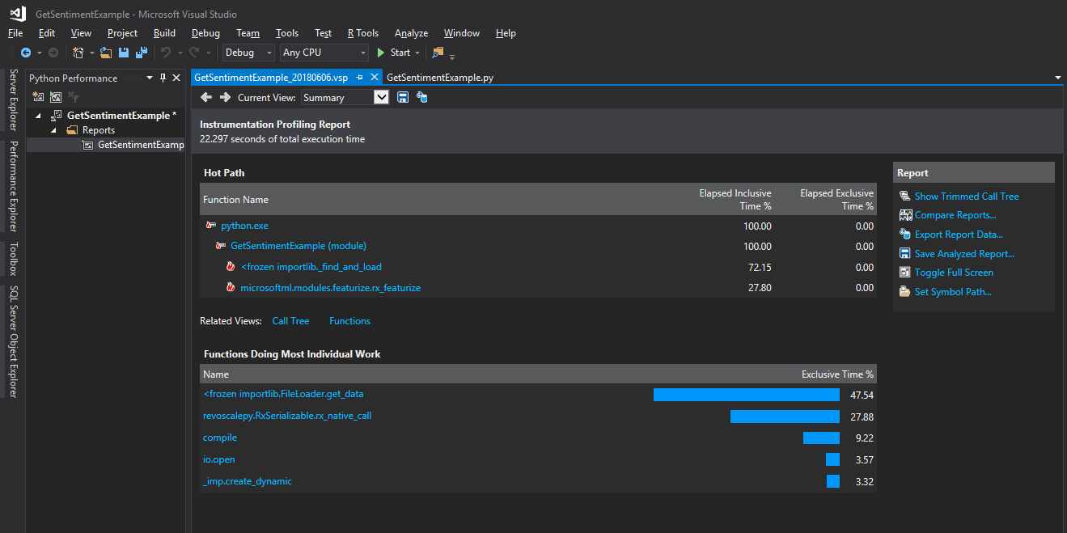
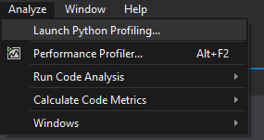

Slide 22
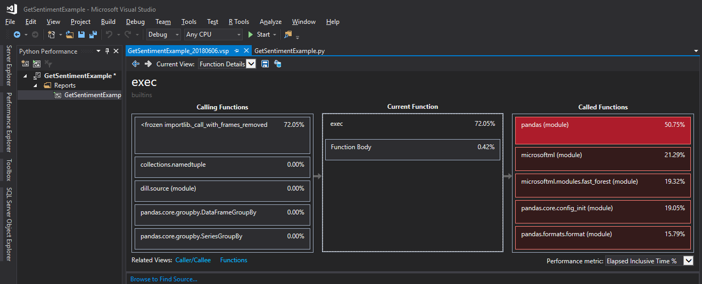

Slide 23
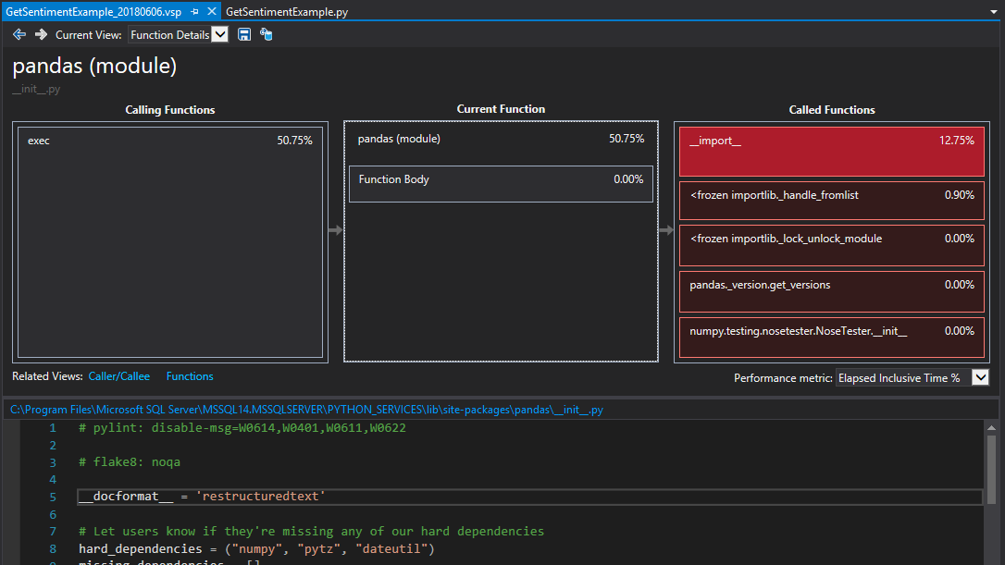

Slide 24
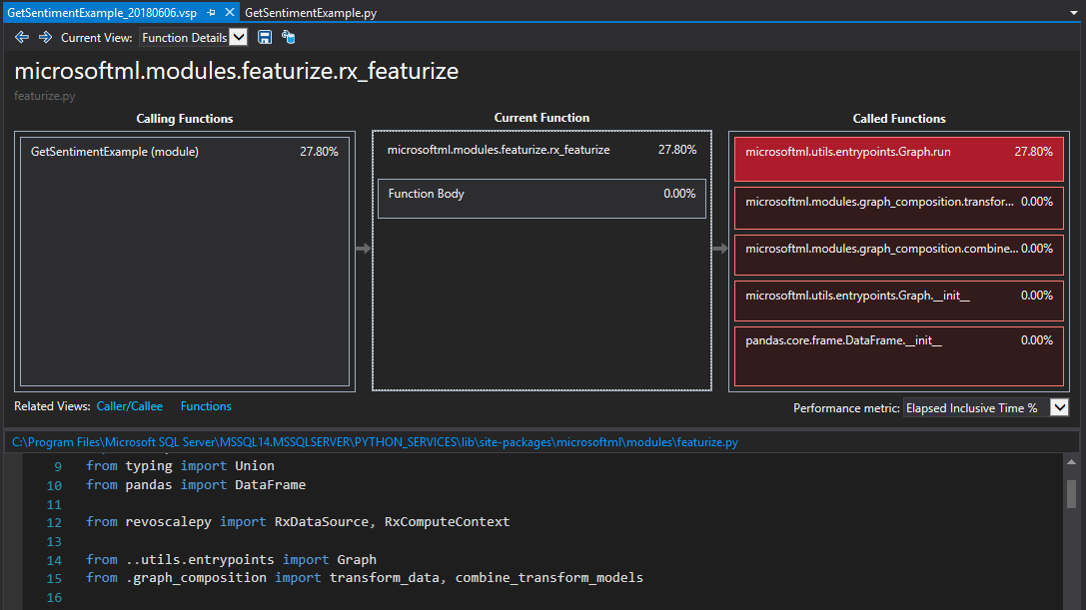

Slide 25
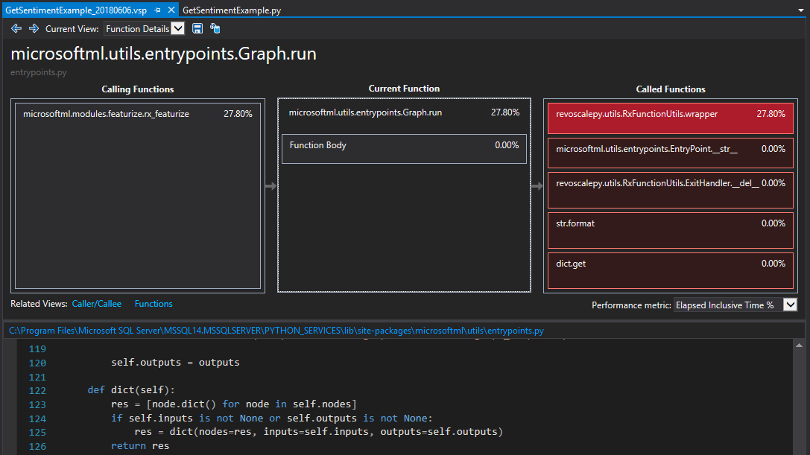

Slide 26
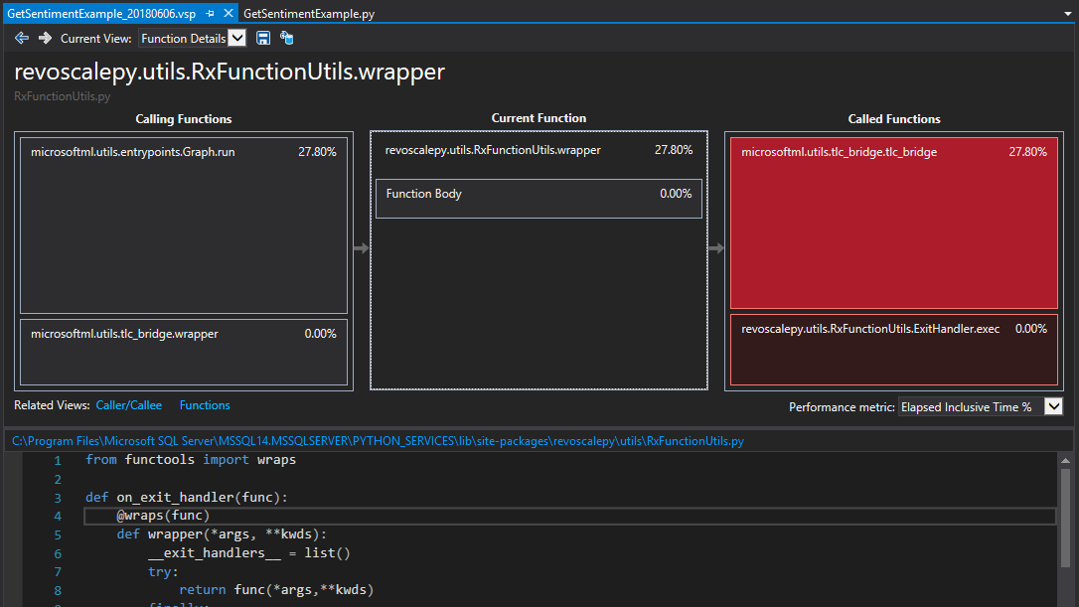

Slide 27
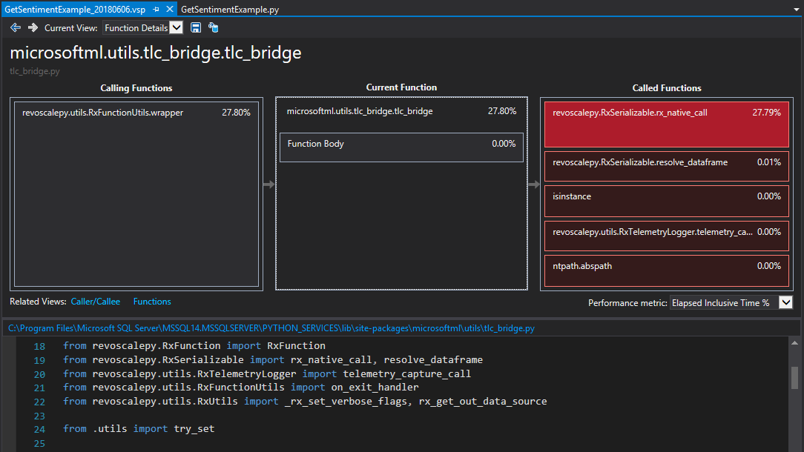

Slide 28
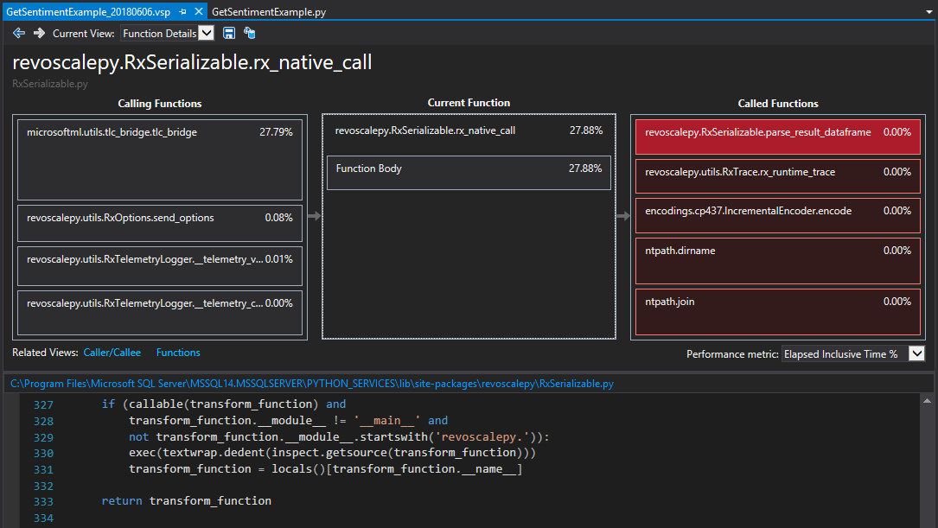

Slide 29
Demo Three
In-Database ML
realtime_scoring_only = True
sp_rxPredict
Performance Metrics

Slide 30
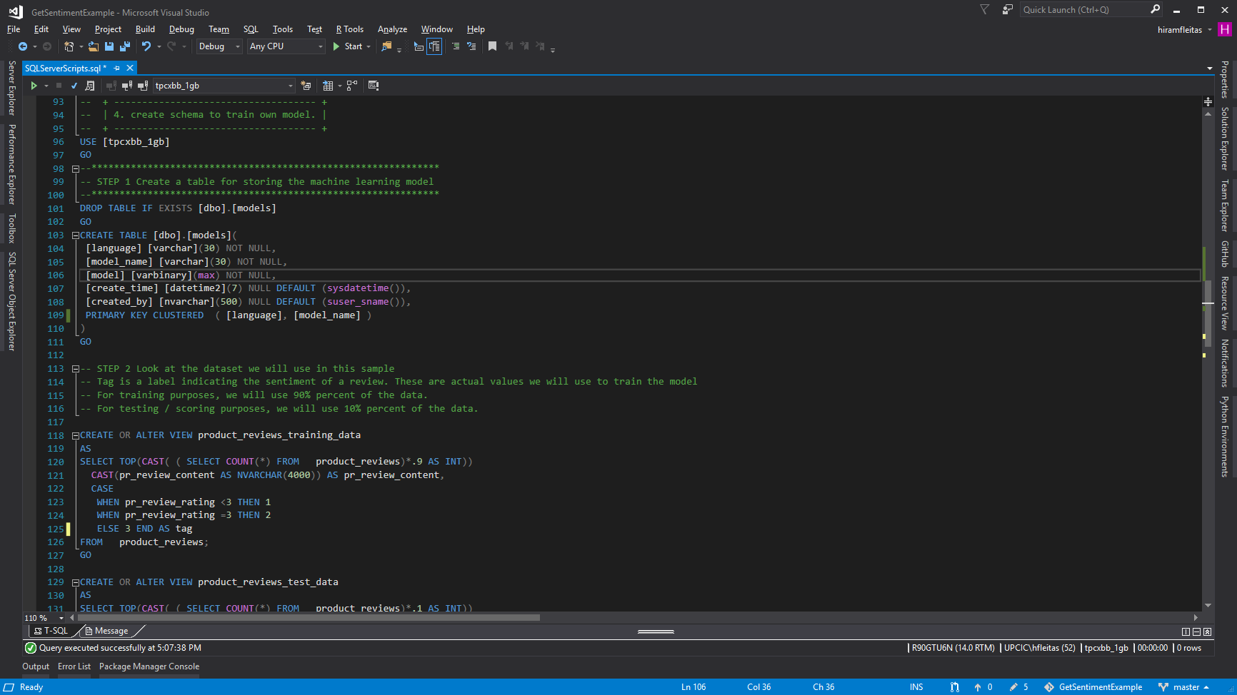
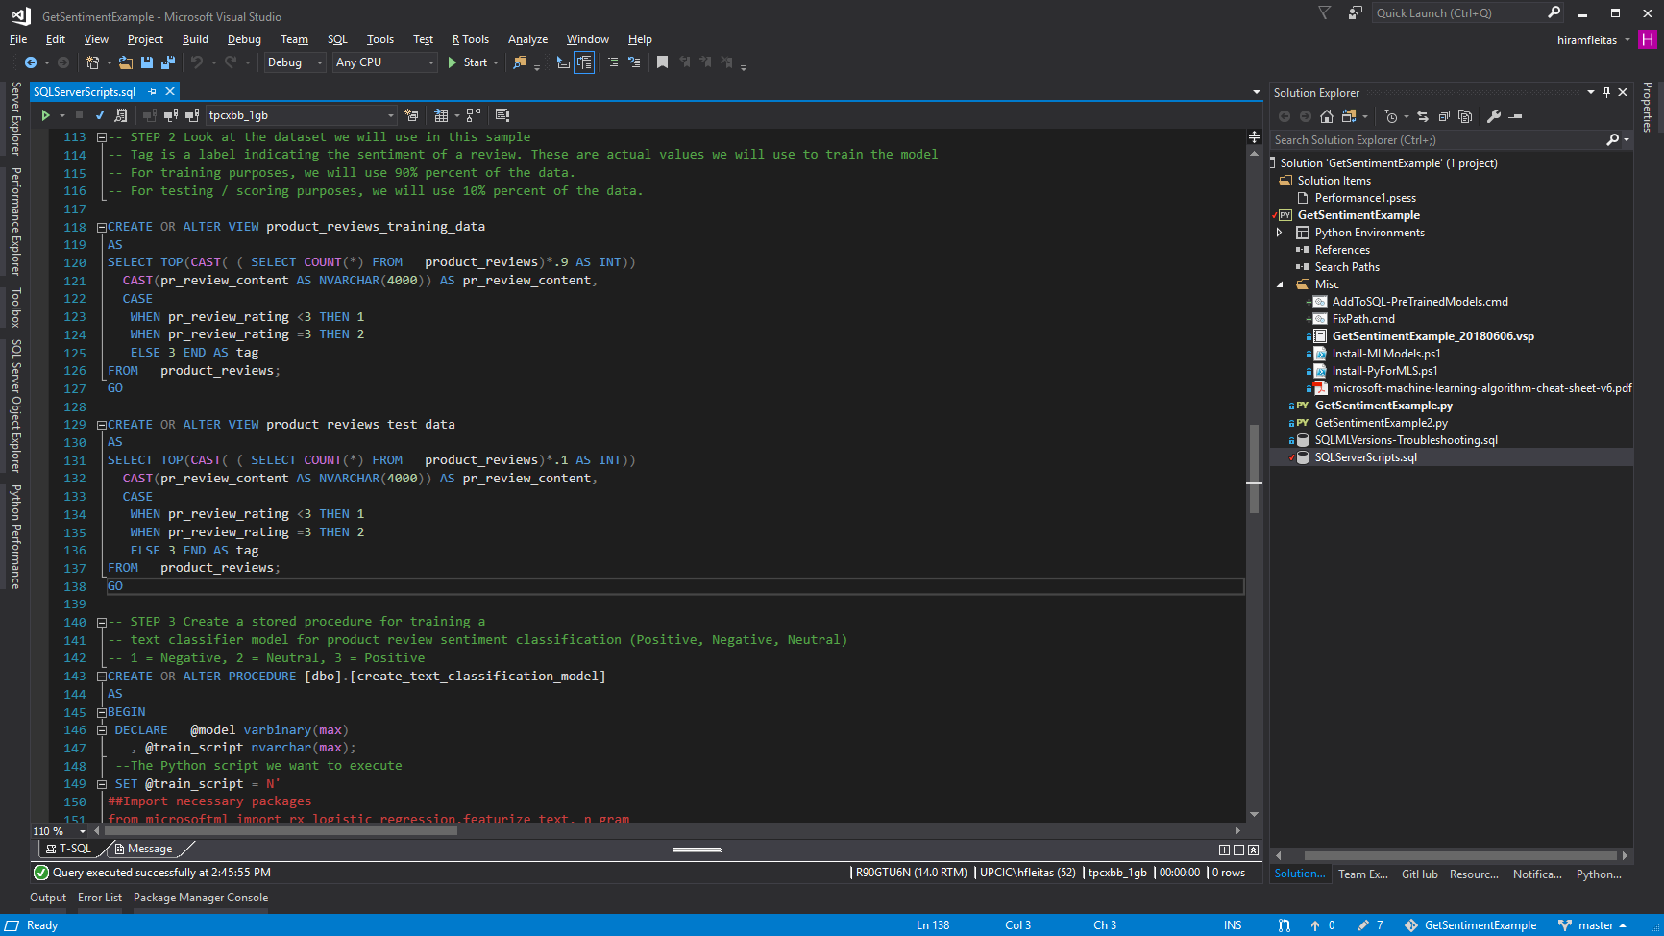
Learn more:
https://blogs.msdn.microsoft.com/sqlserverstorageengine/2017/11/01/sentiment-analysis-with-python-in-sql-server-machine-learning-services
https://sqlchoice.blob.core.windows.net/sqlchoice/static/tpcxbb_1gb.bak
Notes:
Learn more:
https://blogs.msdn.microsoft.com/sqlserverstorageengine/2017/11/01/sentiment-analysis-with-python-in-sql-server-machine-learning-services
https://sqlchoice.blob.core.windows.net/sqlchoice/static/tpcxbb_1gb.bak

Slide 31
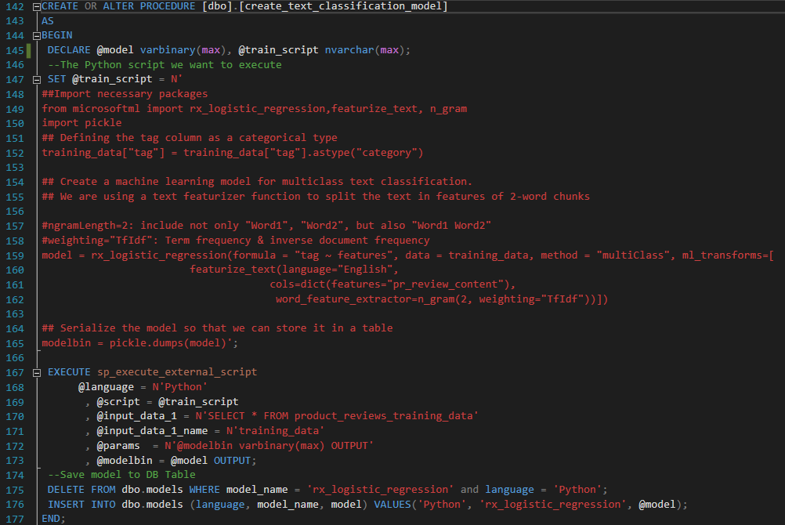
Learn more:
https://blogs.msdn.microsoft.com/sqlserverstorageengine/2017/11/01/sentiment-analysis-with-python-in-sql-server-machine-learning-services
https://sqlchoice.blob.core.windows.net/sqlchoice/static/tpcxbb_1gb.bak

Slide 32
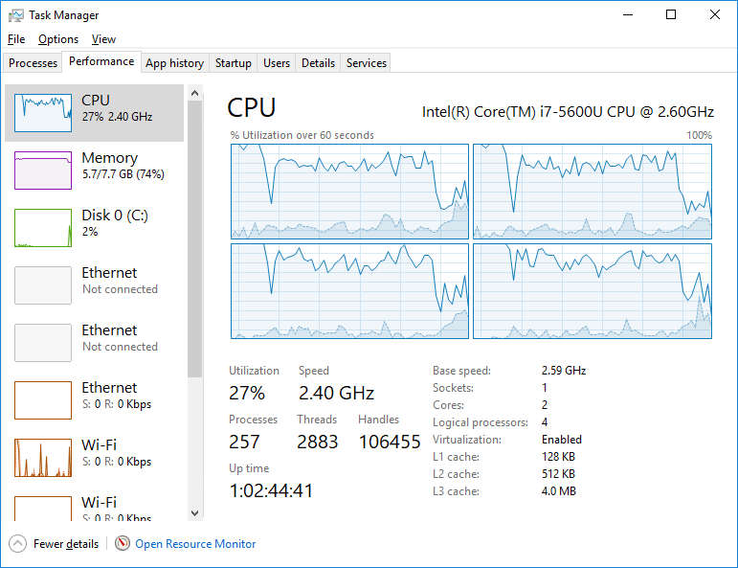
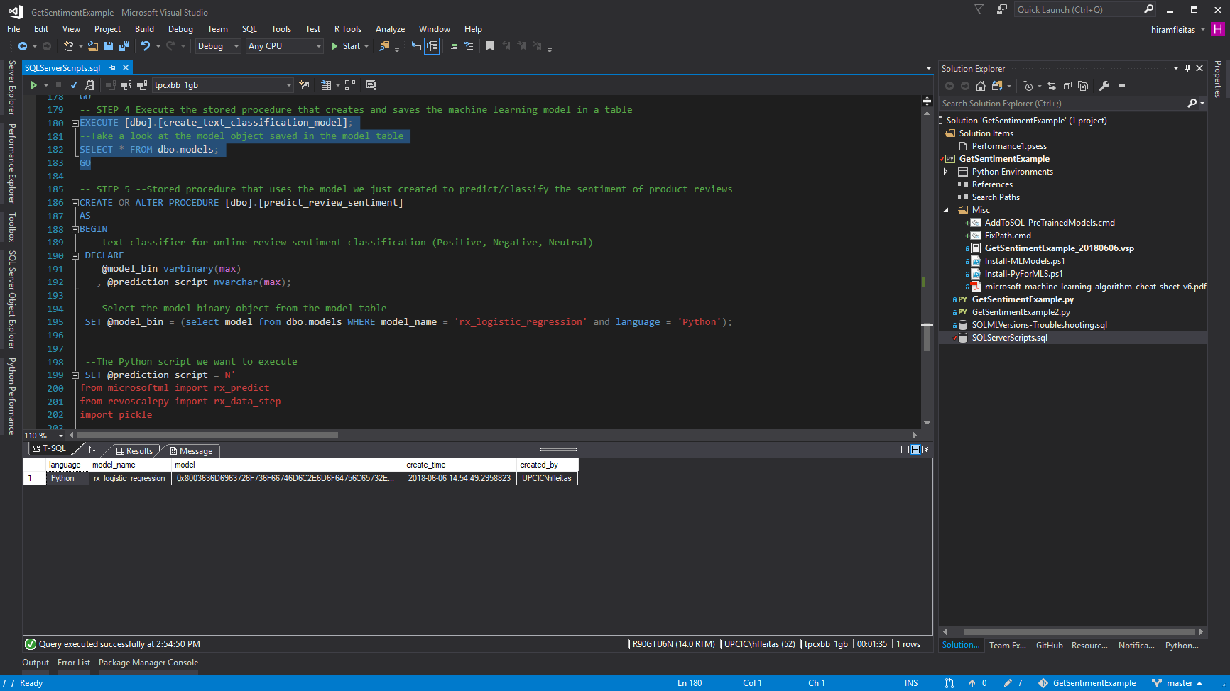
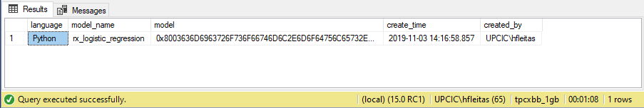
Total execution time
SQL Server 2017: 00:01:35
SQL Server 2019: 00:01:08
Learn more:
https://blogs.msdn.microsoft.com/sqlserverstorageengine/2017/11/01/sentiment-analysis-with-python-in-sql-server-machine-learning-services
https://sqlchoice.blob.core.windows.net/sqlchoice/static/tpcxbb_1gb.bak

Slide 33
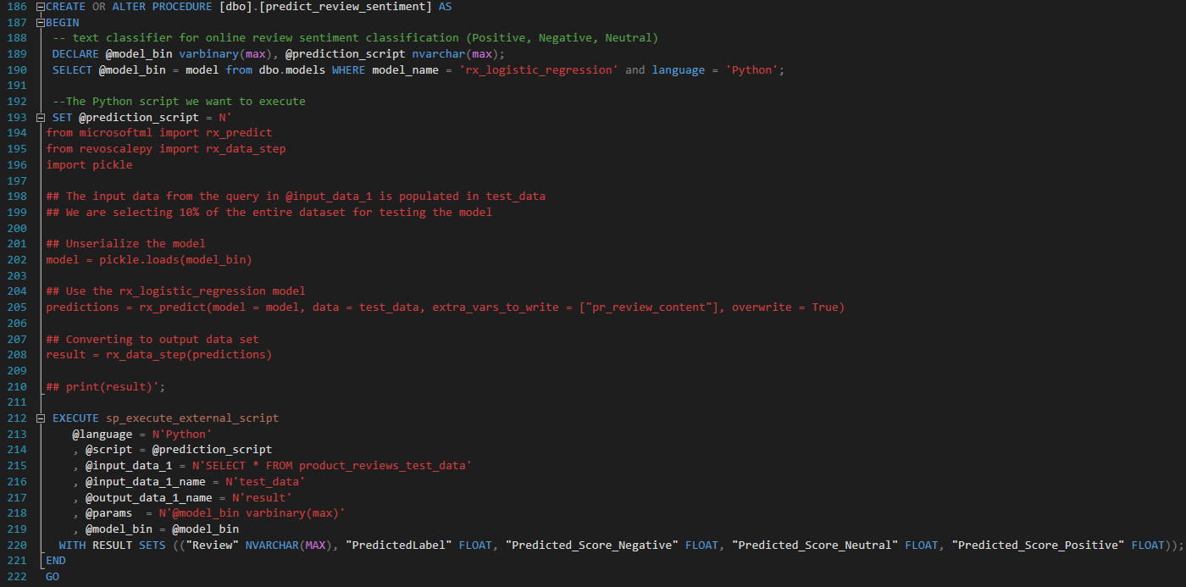

Slide 34
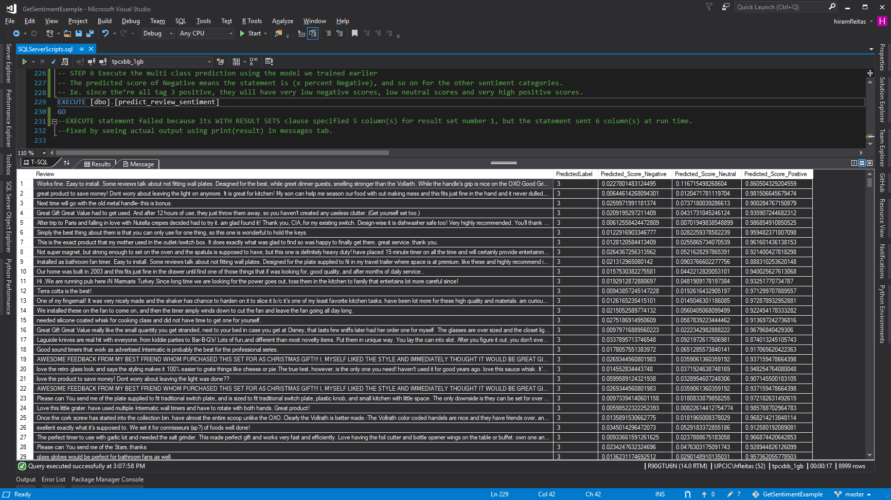
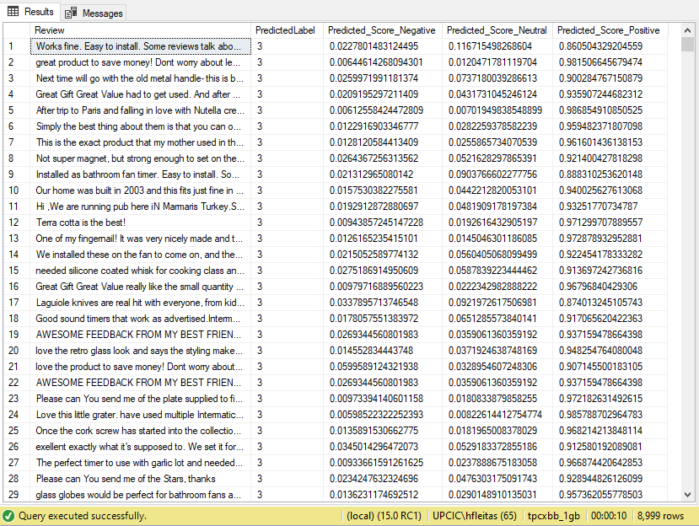
Total execution time
SQL Server 2017: 00:00:17
SQL Server 2019: 00:00:10

Slide 35
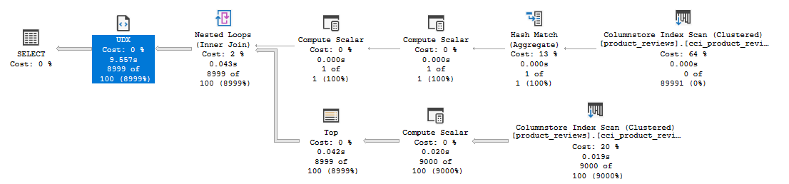
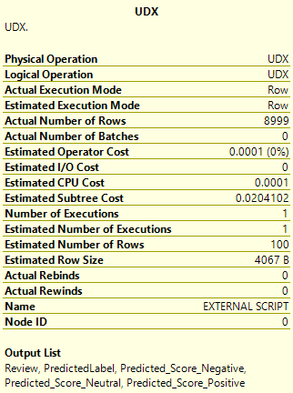
Execution Plan
Total execution time
SQL Server 2017: 00:00:17
SQL Server 2019: 00:00:10

Slide 36
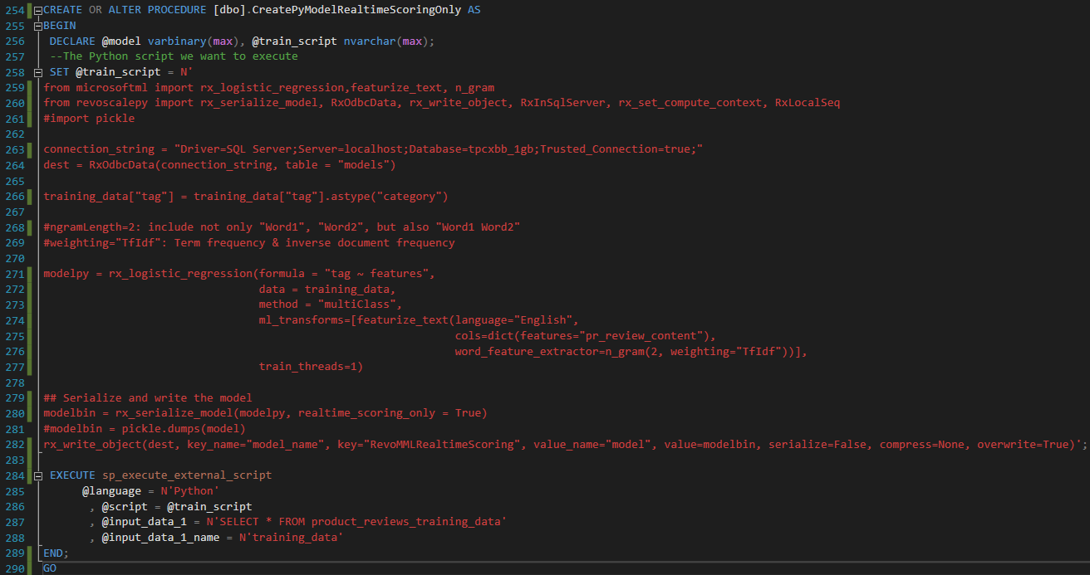

Slide 37
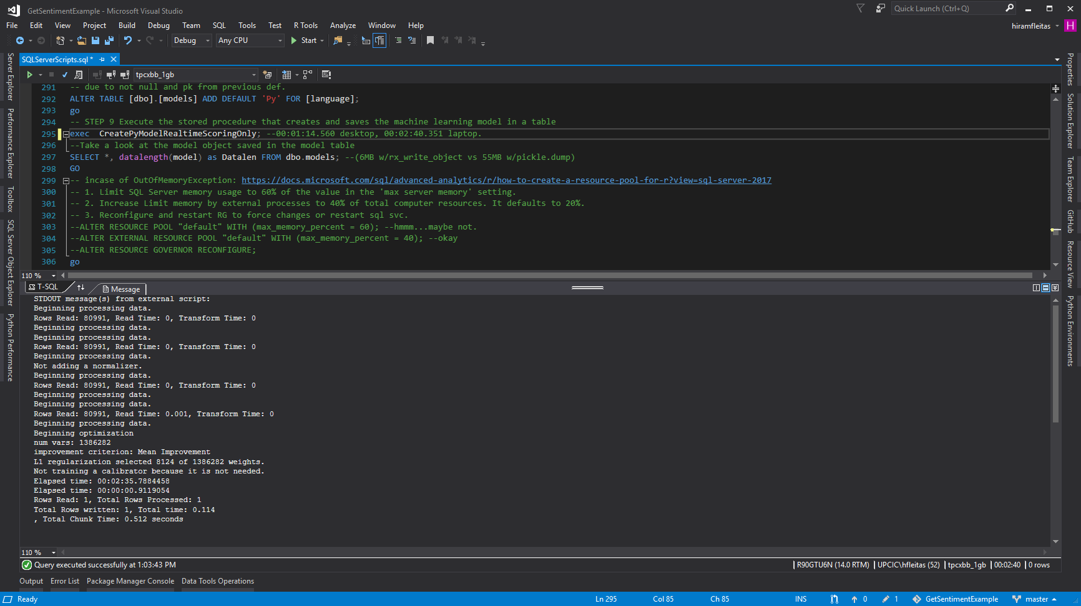
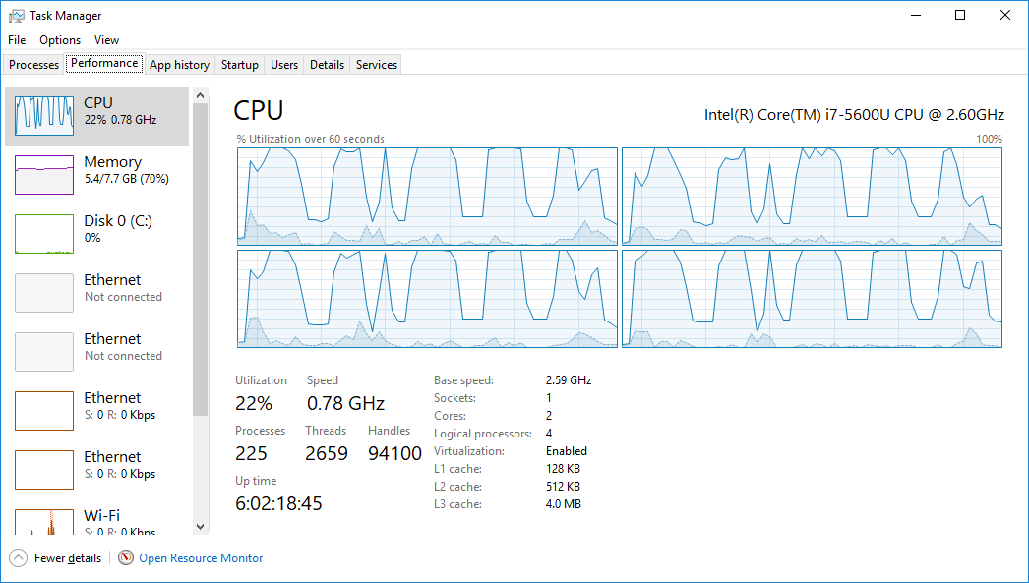
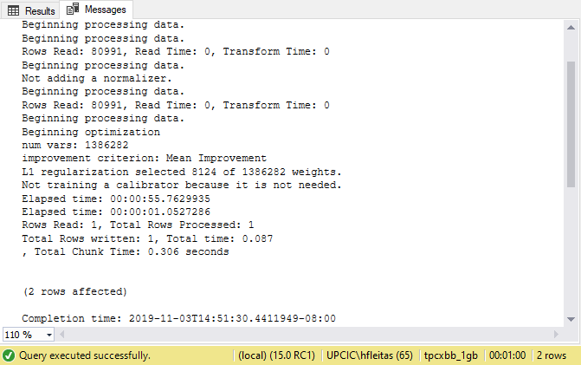
Total execution time
SQL Server 2017: 00:02:40
SQL Server 2019: 00:01:00
Total execution time
SQL Server 2017: 00:00:17
SQL Server 2019: 00:00:10

Slide 38
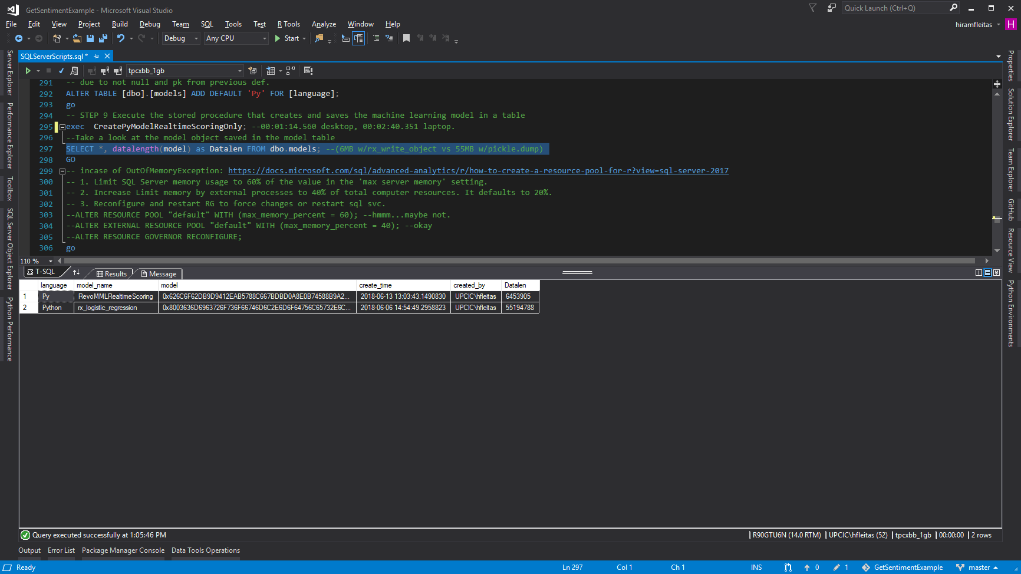


Let’s try sp_rxPredict
Learn more:
https://docs.microsoft.com/en-us/sql/advanced-analytics/r/how-to-do-realtime-scoring

Slide 39


Slide 40


Learn more:
https://docs.microsoft.com/en-us/sql/advanced-analytics/r/how-to-do-realtime-scoring

Slide 41


Slide 43
Demo Four
(T-SQL) for json path
(Python) json_normalize
CognitiveAPI.ipynb
Trollhunters.ipynb
(PDF) TrumpUkraine.ipynb

Slide 44

Learn more:
https://docs.microsoft.com/azure/cognitive-services/text-analytics/quickstarts/python
https://azure.microsoft.com/services/cognitive-services/text-analytics

Slide 45

Learn more:
https://docs.microsoft.com/sql/relational-databases/json/format-nested-json-output-with-path-mode-sql-server

Slide 46



Slide 47

Learn more:
https://docs.microsoft.com/sql/relational-databases/json/format-nested-json-output-with-path-mode-sql-server
https://docs.microsoft.com/sql/relational-databases/system-stored-procedures/sp-execute-external-script-transact-sql

Slide 48



Slide 49

Upgrade via Notebook

Slide 50

Learn more:
How to output values from sp_execute_external_script into table
Convert JSON API response to pandas Dataframe

Slide 51

Learn more:
https://repl.it/languages/python3

Slide 52

Learn more:
https://tvtropes.org/pmwiki/pmwiki.php/Quotes/Trollhunters
https://netflix.com/trollhunters

Slide 53


Slide 54

Learn more:
https://repl.it/languages/python3

Slide 55
Learn more:
https://repl.it/languages/python3

Slide 56


Slide 57


Slide 58


Slide 59


Slide 60


Slide 61


Slide 62


Slide 63


Slide 64


Slide 65


Slide 66

PDF
Get Cognitive API
Learn more:
https://repl.it/languages/python3

Slide 67


Slide 68


Slide 69
Demo Five
2016 vs 2017 vs 2019
Paginated Report (RDL – PBIRS)
Terms & Ethics
Streaming (Spark – BDC)

Slide 70

SQL Server 2016 (8 vCores, 72 GBs RAM, same storage)
Learn more:
https://aka.ms/ss19

Slide 71

SQL Server 2017 (4 vCores, 64 GBs RAM, same storage)
Learn more:
https://aka.ms/ss19

Slide 72

SQL Server 2019 (4 vCores, 64 GBs RAM, same storage…same VM as previous)
Learn more:
https://aka.ms/ss19

Slide 73

Learn more:
Hide Column based up Parameter Selected SSRS

Slide 74

Learn more:
https://www.yelp.com/developers/api_terms
https://www.yelp.com/developers/display_requirements

Slide 75

Learn more:
SQL Server Samples - Big Data Clusters - Spark

Slide 76

Learn more:
SQL Server Samples - Big Data Clusters - Spark

Slide 77

Learn more:
SQL Server Samples - Big Data Clusters - Spark

Slide 78
Resources
fleitasarts.com
bit.ly/gaib2019
netflix.com/trollhunters
aka.ms/sqldev
microsoft.github.io/sql-ml-tutorials
ailab.microsoft.com
github.com/microsoft/sql-server-r-services-samples
myignite.microsoft.com/sessions/81038

Slide 79
Workshops
Azure Custom Vision
Azure Machine Learning designer
Automated ML UI
ML.Net
Azure Machine Learning SDK
Cloud Scale Machine Learning

Slide 80

Sentiment Prediction Real-time in SQL Server
Thank You
Hiram Fleitas
@hiramfleitas
bit.ly/gaib2019
hiram@fleitasarts.com
fleitasarts.com
/hfleitas
hiramfleitas

